Slide 1
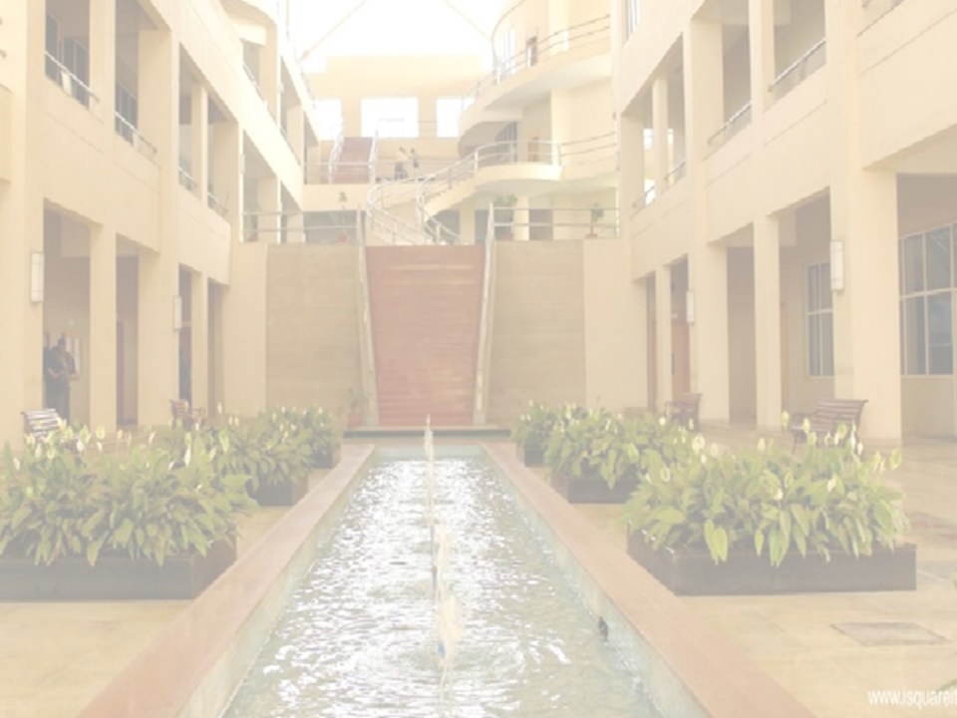

LAND POLLUTION
MAHESH S WAGHMARE
Department of Engineering Sciences
International Institute of Information Technology, I²IT
www.isquareit.edu.in

Slide 2

What is Land Pollution
Land Pollution is due to deterioration of the earth’s land surface.
It is happening due to direct and indirect activities by human beings.
If we misuse the land resources then land pollution takes place.

Slide 3
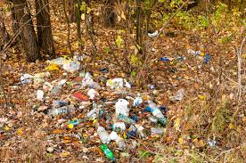
CAUSES OF LAND POLLUTION
Deforestation and consequent erosion
Illegal dumping of waste
Urbanisation and construction
Agriculture and industry
Mining

Slide 4
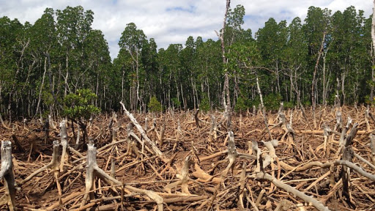
Deforestation
It is permanent removal of trees to make a space in the forest. It includes clearing the land for agricultural or grazing. The forest covers more than 30% of the earth’s land surface.

Slide 5
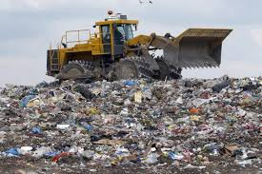
Illeagal dumping of waste
It is also called as fly dumping where dumping of waste is illegally done instead of authorised method.

Slide 6
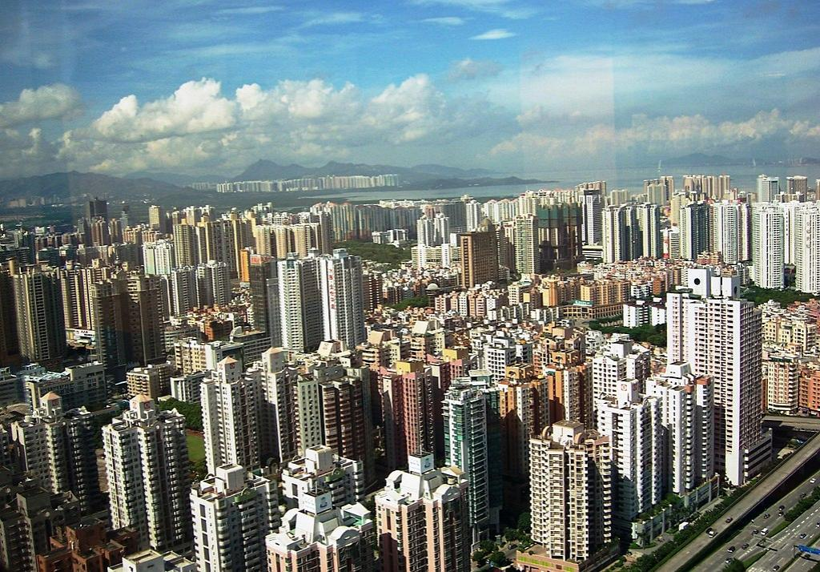
Urbanisation and construction
In this process people moves from rural area to urban area.so construction activities are increasing and land pollution takes place.

Slide 7
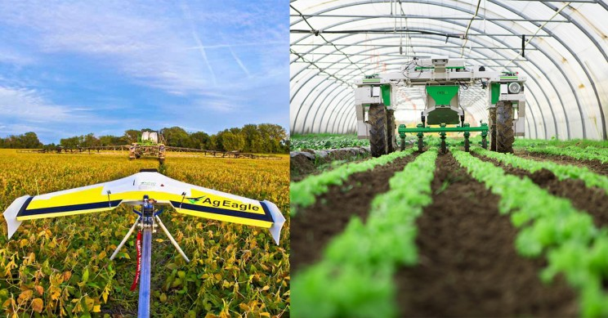
Agricultural and industry
In this process the spreading of plant protection product like pesticides and herbicides and farms are the origin of land pollution.

Slide 8
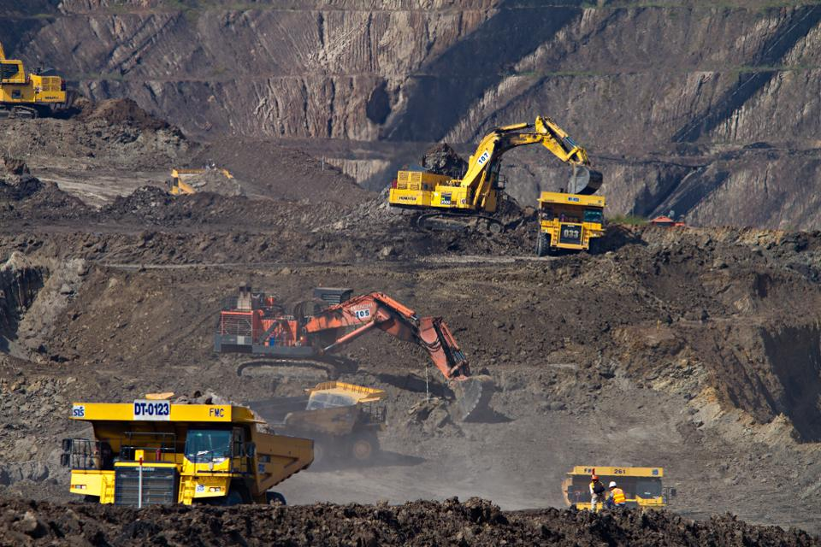
Mining
In mining process there is erosion, sinkholes, and loss of biodiversity. Also due to this process there is a contamination of soil, ground water, and surface water by chemicals emitted from mining process.

Slide 9
Effect of Land Pollution
Soil pollution
Change on climate pattern
Environmental Impact
Effect on human health
Causes air pollution
Distraction for tourists
Effect on wild life

Slide 10
Solution for land pollution
People should aware about 3Rs, Like Reduce, Recycle, Reuse….
Try to reduce pesticides and fertilizers in agricultural activities.
People should avoid buying packages item which lead to create garbage and end at landfill site.
Use biodegradable product.

Slide 11
References
www.google.com
www.india.gov.in
http://eschooltoday.com/
https://www.britannica.com/science/land-pollution
https://www.conserve-energy-future.com/causes-effects-solutions-of-land-pollution.php

Slide 12
THANK YOU
Mahesh Waghmare
Asst. Professor in Civil Engineering
maheshw@isquareit.edu.in

