Slide 1
AVL TREE
Prof. Manjusha Amritkar
Information Technology Department
International Institute of Information Technology, I²IT
www.isquareit.edu.in

Slide 2
Binary Search Tree
2
E.g. 2,4,6,8,10
Right skewed tree
Time needed to perform insertion ,deletion and many other operations is O(N) in worst case.
We need tree with small height with Log N
Such trees are called as Balanced Binary Search Tree
e.g AVL tree, Red Black Tree
4
6
8
10

Slide 3
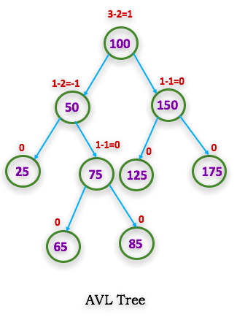
AVL Tree
AVL tree Named after their inventor Adelson, Velski & Landis, is a self-balancing Binary Search Tree (BST) where the difference between heights of left and right subtrees cannot be more than one for all nodes.
The difference between the heights is called
as balanced factor (BF)
BF = height (left subtree) – height (right subtree)
The tree is balanced when BF is -1, 0, 1

Slide 4
AVL Tree Rotations
If the difference is more than one then the tree is to be balanced using rotations.
Left rotation (LL)
Right rotation (RR)
Left-Right rotation (LR)
Right-Left rotation (RL)

Slide 5
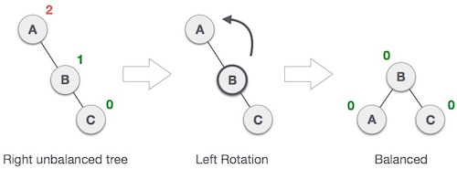
Left Rotation
If a tree becomes unbalanced, when a node is inserted into the right subtree of the right subtree, then we perform a single left rotation

Slide 6
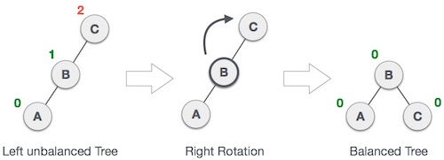
Right Rotation
AVL tree may become unbalanced, if a node is inserted in the left subtree of the left subtree. The tree then needs a right rotation

Slide 7
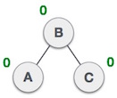
Left Right Rotations
A node has been inserted into the right subtree of the left subtree. This makes C an unbalanced node. These scenarios cause AVL tree to perform left-right rotation.
LR Rotation

Slide 8
Right Left Rotations
A node has been inserted into the left subtree of the right subtree. This makes A, an unbalanced node with balance factor 2.
RL Rotation

Slide 9
Example: Construct an AVL Tree by inserting numbers from 1 to 8.

Slide 10
Example: Construct an AVL Tree by inserting numbers from 1 to 8.

Slide 11
Example: Construct an AVL Tree by inserting numbers from 1 to 8.

Slide 12
Example: Construct an AVL Tree by inserting numbers from 1 to 8.

Slide 13
Example: Construct an AVL Tree by inserting numbers from 1 to 8.

Slide 14
Example: Construct an AVL Tree by inserting numbers from 1 to 8.

Slide 15
Example: Construct an AVL Tree by inserting numbers from 50,25,10,5,7,3,30,20,8,15.
Insert 50
Insert 25
0
50
Tree is balanced
1
50
Tree is balanced
0
25

Slide 16
Example: Construct an AVL Tree by inserting numbers from 50,25,10,5,7,3,30,20,8,15.
Insert 10
2
50
1
25
1
25
RR Rotation
0
0
10
50
0
10
Tree is balanced
Tree is imbalanced

Slide 17
Example: Construct an AVL Tree by inserting numbers from 50,25,10,5,7,3,30,20,8,15.
Insert 5 insert 7
1
2
1
25
25
25
1
0
2
0
0
10
LR Rotation
0
10
50
50
7
50
0
-1
0
0
5
5
5
10
0
7
Tree is imbalanced
Tree is balanced
Tree is balanced

Slide 18
Example: Construct an AVL Tree by inserting numbers from 50,25,10,5,7,3,30,20,8,15.
Insert 3
2
25
0
7
1
0
7
50
1
0
LL Rotation
5
25
1
0
5
0
0
0
10
3
10
50
0
3
Tree is imbalanced
Tree is balanced

Slide 19
Example: Construct an AVL Tree by inserting numbers from 50,25,10,5,7,3,30,20,8,15.
Insert 30 insert 20
0
-2
-1
10
7
7
1
0
1
1
RL Rotation
7
1
-1
5
25
25
5
25
1
0
-1
0
1
0
1
5
0
0
1
3
10
8
20
50
50
3
10
50
1
0
0
0
8
20
3
0
0
15
30
50
30
Tree is balanced
30
0
15
Tree is imbalanced

Slide 20
References
http://www.btechsmartclass.com/data_structures/avl-trees.html

Slide 21
Thank You
E-mail: manjushaa@isquareit.edu.in

