Slide 1
LR(0) PARSER
Mr.Sameer Prembabu Mamadapure
Information Technology Department
International Institute of Information Technology, I²IT
www.isquareit.edu.in

Slide 2
LR(k) Parsers
Left-to-right, rightmost derivation with k-token lookahead.
Most general parsing technique for deterministic grammars.
In general, not practical: tables too large (10^6 states for C++, Ada).
Common subsets: SLR, LALR (1).

Slide 3
The states of the LR(0) automaton
An item is a point within a production, indicating that part of the production has been recognized:
A α. Bβ ,
seen the expansion of α, expect to see expansion of B
A state is a set of items
Transition within states are determined by terminals and non-terminals
Parsing tables are built from automaton:
action: shift / reduce depending on next symbol
goto: change state depending on synthesized non-terminal

Slide 4
Building LR (0) states
If a state includes:
A α .Bβ
it also includes every state that is the start of B:
B . X Y Z
Informally: if I expect to see B next, I expect to see anything that B can start with, and so on:
X . G H I
States are built by closure from individual items.

Slide 5
A grammar of expressions: initial state
E’ E
E E + T | T; -- left-recursion ok here.
T T * F | F;
F id | (E)
S0 = { E’ .E, E .E + T, E .T,
F .id, F . ( E ) ,
T .T * F, T .F }

Slide 6
Adding states
If a state has item A α .a β,
and the next symbol in the input is a, we shift a on the stack and enter a state that contains item
A α a.β
(as well as all other items brought in by closure)
if a state has as item A α. , this indicates the end of a production: reduce action.
If a state has an item A α .N β, then after a reduction that find an N, go to a state with A α N. β

Slide 7
Construction of a predictive parsing table
The following rules are used to construct the predictive parsing table:
1. for each terminal a in FIRST(α),
add A → α to matrix M[A,a]
2. if λ is in FIRST(α), then
for each terminal b in FOLLOW(A),
add A → α to matrix M[A,b]

Slide 8
The LR (0) states for expressions
S1 = { E’ E., E E. + T }
S2 = { E T., T T. * F }
S3 = { T F. }
S4 = { F (. E), } + S0 (by closure)
S5 = { F id. }
S6 = { E E +. T, T .T * F, T .F, F .id, F .(E)}
S7 = { T T *. F, F .id, F .(E)}
S8 = { F (E.), E E.+ T}
S9 = { E E + T., T T.* F}
S10 = { T T * F.}, S11 = {F (E).}

Slide 9
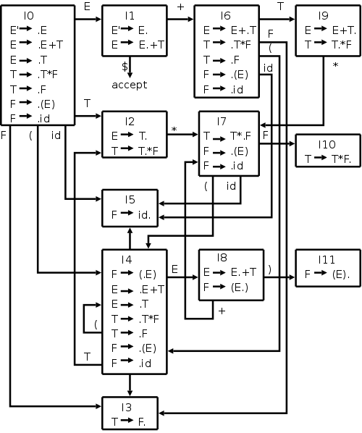
LR(0) Automaton

