Slide 1
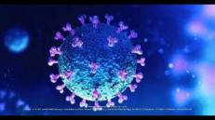
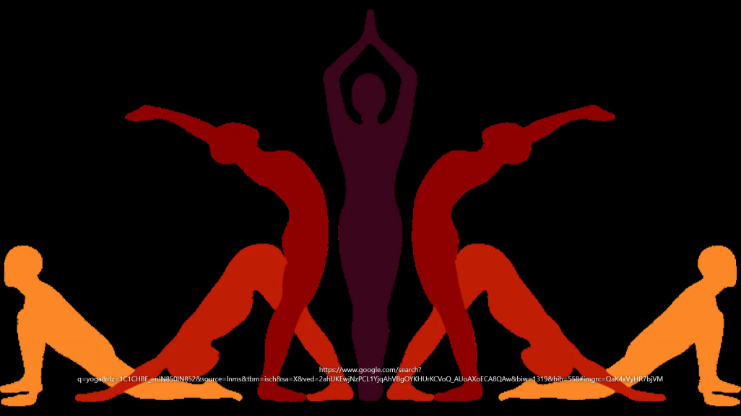
YOGA TO FIGHT & WIN AGAINST COVID-19
Ankita Dhone
Physical Education Director
I²IT, Hinjawadi, Pune 411057

Slide 2
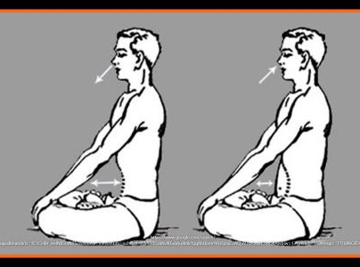
Shuddhikriya
Kapalbhati (Breath of Fire)
It is the continuous exhalations after emptying the lungs completely. It helps in removing out old air with filling fresh air from the surrounding.
It enhance gases exchange process properly (Internal Breathing)
This activity Strengthen Lungs, increase lung capacity.

Slide 3
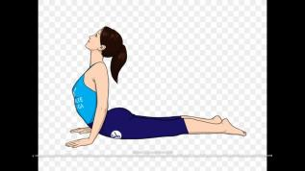
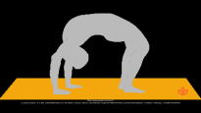
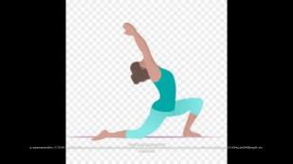
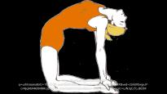
ASANAS
Bhujangasana
Chakrasana
Ushtrasana
Anjaneyasana

Slide 4
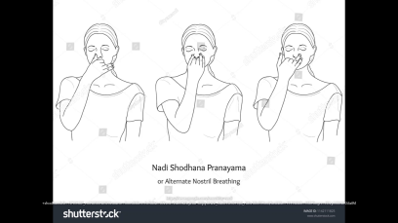
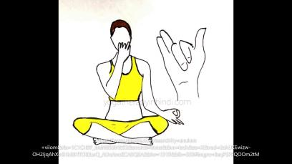
PRANAYAM
Nadi Shodhan
Anulom Vilom

Slide 5
MASSAGE
Gentle Massage to base of the Sternum, clockwise and anticlockwise with gentle breathing.
Sternum is the Breastbone.
Massage on the naked portion with finger tips.
Use Powder or oil for uninterrupted friction.

Slide 6
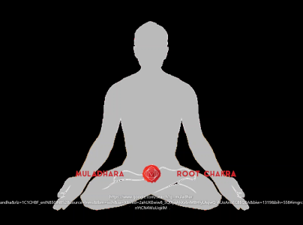
BANDHA
Mulabandha is contracting the anal muscles upward. Root Chakra is present there.
To be done throughout the session wherever possible and compulsorily during Meditation and Instructions.
Mulbandha restores Apana Vayu which disturbs the sleeping KUNDALINI, helps in Kundalini activation.

Slide 7
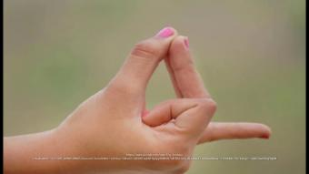
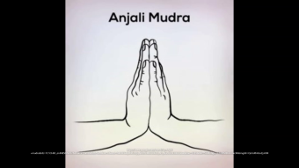
MUDRA
Hridaya Mudra
Hridaya Mudra helps in activating Anahat Chakra.
Anjali Mudra
Anjali Mudra should be done with thumbs joined and gently pressing the base of the Sternum

Slide 8
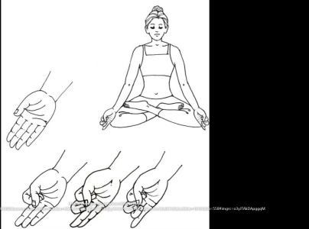
MEDITATION
Meditate with recitation of Bij Mantra 'YAM'
While meditating keep the focus at the base of the heart.
Use Hriday Mudra During Meditation.

Slide 9
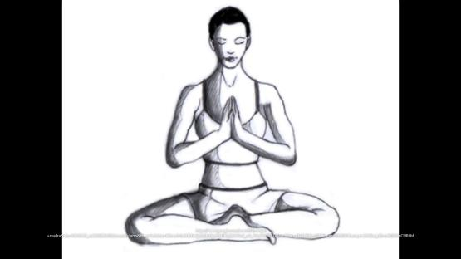
INSTRUCTIONS TO THE BODY
Oh THYMUS wake up. You need to regenerate now as my body needs you, you are a part my body. You are required to get activated again in order to meet further challenges by providing regular production of updated T-Cells throughout my life.
Use Anjali Mudra here.

Slide 10
Yoga is a Lifestyle and not just the part of physical activity.

Slide 11
THANK YOU

