Slide 1
INTRODUCTION
TO
DATA SCIENCE , BIG DATA, DATA ANALYTICS
Prof Ekta M. Choudhari
Department of Information Technology
International Institute of Information Technology, I²IT
www.isquareit.edu.in

Slide 2
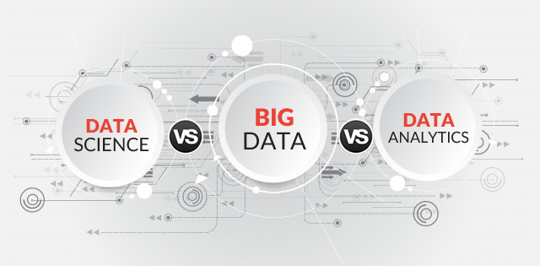

Slide 3
Introduction to Data science
“Data science, Know as data-driven science, is also an interdisciplinary field of scientific methods, processes, algorithms, and systems to extract knowledge or insights from data in various forms, either structured or unstructured, similar to data mining. ”

Slide 4
Various sectors use Data Science to extract the information they need to create different services and products.

Slide 5
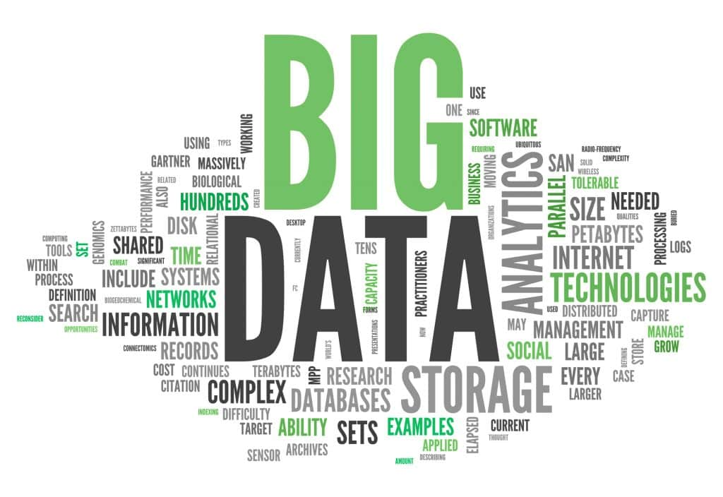

Slide 6
Big Data at a Glance

Slide 7
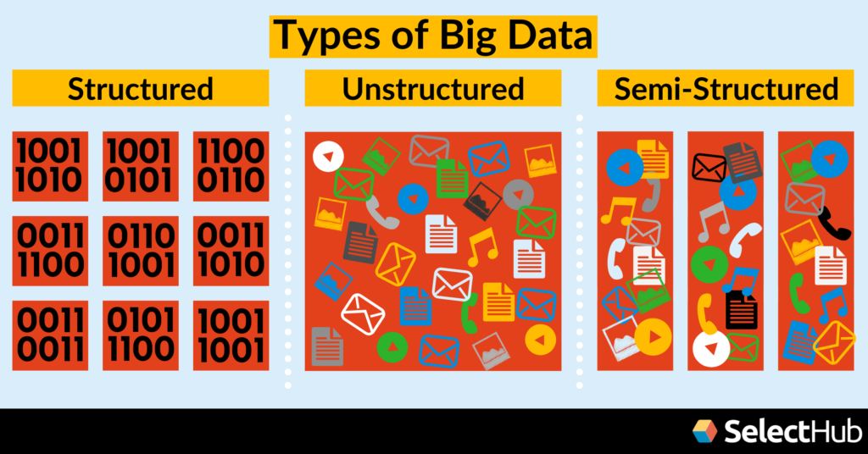
Different Types of Data

Slide 8
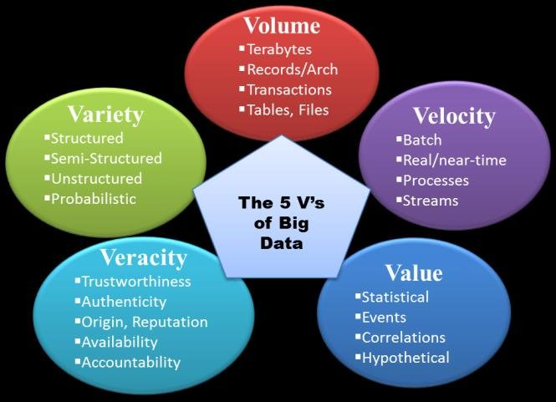
5 V’s of Big Data

Slide 9
Challenges of Traditional Systems (RDBMS &DWH)

Slide 10
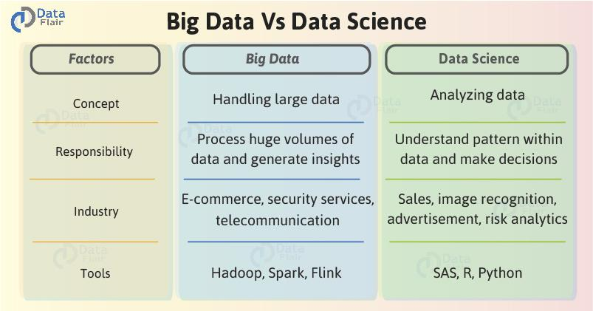

Slide 11
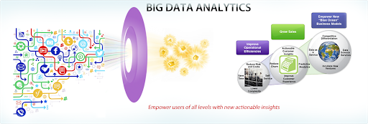
What Is Data Analytics?
Data analytics is the science of analyzing raw data in order to make conclusions about that information. Many of the techniques and processes of data analytics have been automated into mechanical processes and algorithms that work over raw data for human consumption.

Slide 12
Some of the Companies using Big Data

Slide 13
Common Job Titles
The most common careers in data science and big data field include the following roles.
Data scientists
Data analysts
Big Data Specialists

