Slide 1
Data visualization using power bi how to connect Microsoft forms to power bi Prof. Bhavana Kanawade Department of information technology international institute of information technology,I²IT www.isquareit.edu.in

Slide 2
Applications of power bi
Power BI is –
Business intelligence tool.
Data and analytics reporting tool that helps organizations bring together disparate data
What we are going to look now::::::::::Connect Microsoft forms to Power BI (Feedback analysis)
Visualize Sales Versus Marketing
Take a look at your marketing health.
Take a look at your company's financial
performance in real time.
Generate reports
Feedback analysis
Sentiment analysis

Slide 3
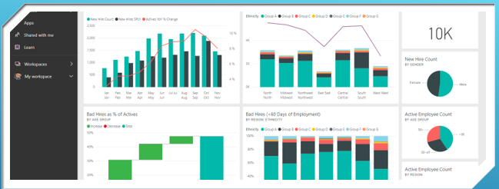
Visualize feedback data entered through forms using different visuals in Power BI

Slide 4
Power Automate
4. Establish link between forms and database
Forms
1. Create form
What you require?
Office365 only
It supports different Apps like forms, power BI, Power Automate
Power BI
2. Generate Database
3. Generate report

Slide 5
Step 1: Create form
Select forms
New quiz
New form
Here u go……….
Add questions in your form

Slide 6
6. Give dataset name
7. Add values and select datatype (questions in form)
8. Turn on historic data analysis
9. Select create and done
4. Select API
5. Next
Step 2: Generate database
Select My workspace
New
Streaming dataset

Slide 7
Dataset created
Step 3: Generate report in power BI
1. Select create report

Slide 8
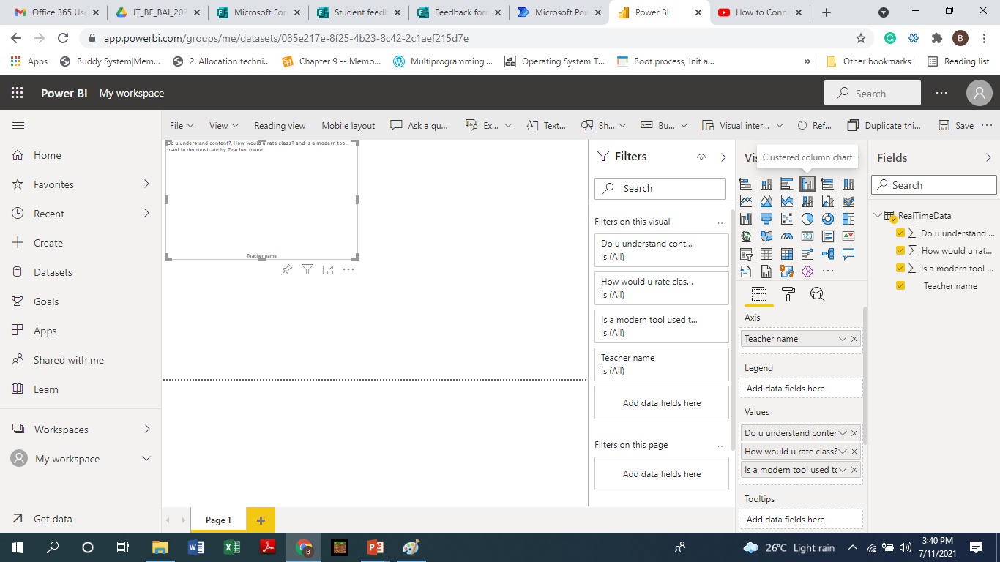
Report fetched attributes of dataset
Step 3: Generate report in power BI
2. Select clustered column chart
3. Add teacher name in axis
4. Add other fields in values
…..still you can not see your data in report wait……..

Slide 9
We are near to completion….yeah….
Step 4. Establish link between form and database
In Power Automate create instant flow and skip the nest step

Slide 10
Create flow
Select “when a new response is submitted”
For next step select forms again
Select forms
Select form id as form name—student feedback form

Slide 11
Select “Get response details”
Select form Id and response id & click on next step
Select Power BI
Select “Add rows to dataset”

Slide 12
Select workspace, dataset and table.
Drag and drop the form fields into the dataset fields
Select save
Submit responses in Microsoft form (Give feedback )

Slide 13
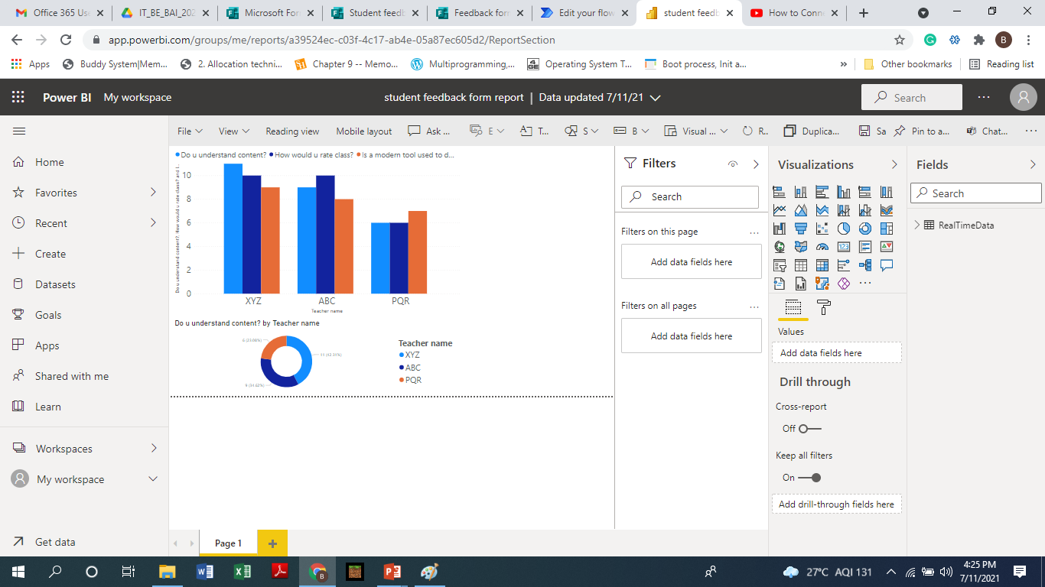
Open report and see your data
Go on adding visuals to understand your data

Slide 14
THANK YOU

