Slide 1
Cloud Computing
Prepared By
Prof. Mukesh More
HOPE FOUNDATION’S
INTERNATIONAL INSTITUTE OF INFORMATION TECHNOLOGY, (I²IT)
www.isquareit.edu.in
+91 20 22933441 / 2

Slide 2
Contents
What is the cloud computing?
Cloud Computing Components
Service Models
Deployment Models
Architecture
Cloud Engineering
Security and Privacy
Cloud Clients
Advanatges
References

Slide 3
What is Cloud Computing?
Cloud computing :
Internet-based computing
large groups of remote servers are networked
sharing of data-processing tasks, centralized data storage, computer services and resources
Any computer related task that is done entirely on Internet

Slide 4
What is Cloud Computing?
Allows users to deal with the software without having the hardware.
Everything is done by remote, nothing is saved locally.

Slide 5
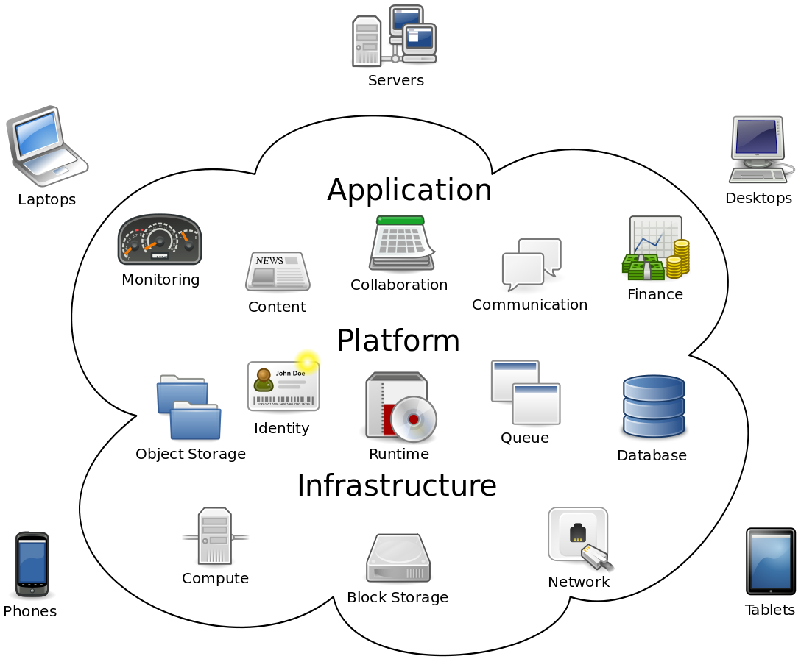
Cloud Computing Components
Fig. 1 Cloud Computing Components [5]

Slide 6
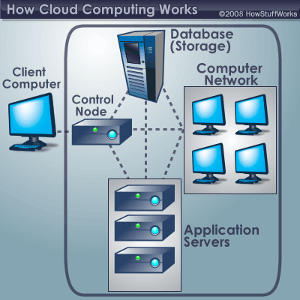
Characteristics
Empowerment
Agility and API
Cost and Security
Device and location independence
Visualization
Multi-tenancy
Reliability and Maintenance
Scalability and Elasticity
Fig. 2 How Cloud Computing Works [6]

Slide 7
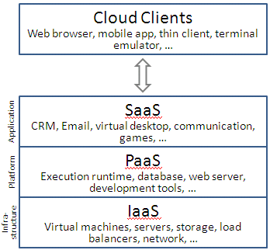
Service Models
Infrastructure as a Service (IaaS)
Basic, service users maintain software
Platform as a Service (PaaS)
Users are given software and hardware automatically
Software as a Service (SaaS)
All software and hardware is transparent
User only knows their own access point
Fig. 3 Service Models of Cloud Computing [7]

Slide 8
Deployment Models
Public cloud
Done by service providers
Community cloud
organizations from a specific community with common concerns
Private cloud
operated solely for a single organization
Hybrid cloud
composition of two or more clouds (private, community or public)
Private Cloud Rentals
option to consider when security is a concern

Slide 9
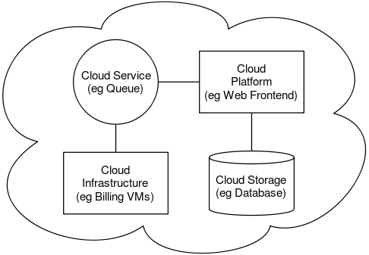
Architecture
The software systems involved in the delivery, communicating over a loose coupling mechanism
The Inter-cloud
The Inter-cloud is an interconnected global "cloud of clouds" and an extension of the Internet
Fig. 4 Cloud Architecture [8]

Slide 10
Cloud Engineering
The application of engineering disciplines to cloud computing
High level concerns
Commercialization
Standardization
Governance in
Conceiving
Developing
Operating
maintaining

Slide 11
Security and privacy
Data protection
Physical Control
Identity management
Physical and personnel security
Availability
Application security
Privacy
Legal issues

Slide 12
Cloud Clients
Google Chrome book
Web browsers
Company specific applications

Slide 13
Advantages
Cloud everyday use
To save huge amounts of data
Easier to maintain information
Makes security easy
Maintainability and sustainability are better

Slide 14
References
[1] "cloud computing." Dictionary.com Unabridged. Random House, Inc. 27 Feb. 2012. <Dictionary.com http://dictionary.reference.com/browse/cloud computing>.
[2] “Cloud computing security.” Wikipedia, The Free Encyclopedia. Wikimedia Foundation, Inc.. 20 Feb 2012. Web. 27 Feb 2012. <http://en.wikipedia.org/wiki/Cloud_computing_security>.
[3] “ Cloud computing.” Wikipedia, The Free Encyclopedia. Wikimedia Foundation, Inc.. 28 February 2012. Web. 27 Feb 2012. <http://en.wikipedia.org/wiki/Cloud_computing>.
[4] nanospeak, . "Top Cloud Computing Companies List To Watch and Invest in 2012." Hub Pages. 10 Feb 2010: n. page. Web. 29 Feb. 2012. <http://nanospeck.hubpages.com/hub/Best-Cloud-Service-Providers>.
[5] https://www.fastmetrics.com/blog/tech/what-is-cloud-computing/
[6] https://computer.howstuffworks.com/cloud-computing/cloud-computing.htm
[7] https://www.ques10.com/p/30825/enlist-and-explain-various-service-model-and-deplo/
[8] https://en.wikipedia.org/wiki/Cloud_computing_architecture

Slide 15
Thank You
For further information please contact
Prof. Mukesh More
Department of Computer Engineering
Hope Foundation’s International Institute of Information Technology, I²IT
Hinjawadi, Pune – 411 057
Phone - +91 20 22933441/9284960835
www.isquareit.edu.in | mukeshm@isquareit.edu.in

