Slide 1
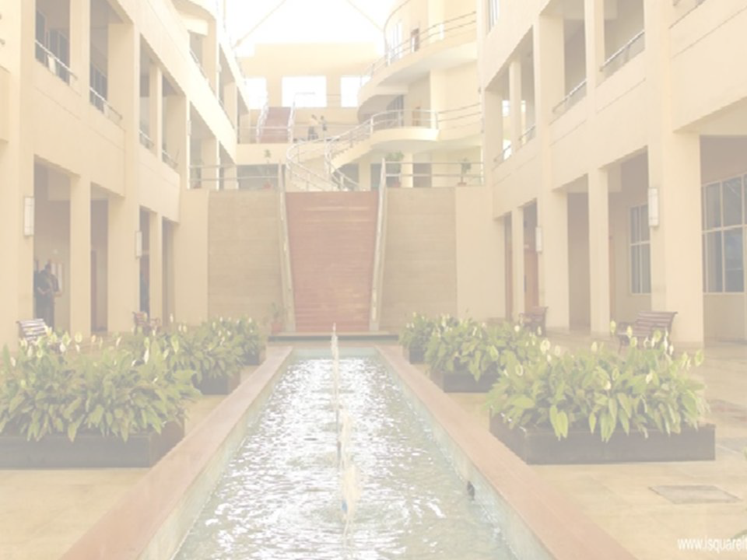
Sentiment Analysis
in
Machine Learning
Prof Pranali V Deshmukh
Department of Information Technology
International Institute of Information Technology, I²IT
www.isquareit.edu.in

Slide 2
Predicting sentiment by topic: An intelligent restaurant review system

Slide 3
It’s a big day & I want to book a table at a nice Japanese restaurant
Seattle has many
★★★★
sushi restaurants
What are people saying about the food?
the ambiance?...

Slide 4
Positive reviews not positive about everything
Experience
Sample review:
Watching the chefs create incredible edible art made the experience very unique.
My wife tried their ramen and it was pretty forgettable.
All the sushi was delicious! Easily best sushi in Seattle.

Slide 5
From reviews to topic sentiments
All reviews for restaurant
Experience
★★★★
Novel intelligent restaurant review app
Ramen
★★★
Sushi
★★★★★
Easily best sushi in Seattle.

Slide 6
Intelligent restaurant review system
All reviews for restaurant
Break all reviews into sentences
The seaweed salad was just OK, vegetable salad was just ordinary.
I like the interior decoration and the blackboard menu on the wall.
All the sushi was delicious.
My wife tried their ramen and it was pretty forgettable.
The sushi was amazing, and the rice is just outstanding.
The service is somewhat hectic.
Easily best sushi in Seattle.

Slide 7
Core building block
Easily best sushi in Seattle.
Sentence Sentiment Classifier
Easily best sushi in Seattle.

Slide 8
Intelligent restaurant review system
B r e a k S e a l l el cret vsieenwtes nces into seanbtoeuntc“essushi”
The seaweed salad was just OK, vegetable salad was just ordinary.
I like the interior decoration and the blackboard menu on the wall.
All reviews for restaurant
Average predictions
Sentence Sentiment Classifier
Sushi
★★★★★
All the sushi was delicious.
All the sushi was delicious.
My wife tried their ramen and it was pretty forgettable.
The sushi was amazing, and the rice is just outstanding.
The sushi was amazing, and the rice is just outstanding.
Most &
The service is somewhat hectic.
Easily best sushi in Seattle.
Easily best sushi in Seattle.
Easily best sushi
in Seattle.

Slide 9
Classifier applications
9
©2015 Emily Fox & Carlos Guestrin
Machine Learning Specialization

Slide 10
Classifier
Sentence from review
Classifier MODEL
Output: y Predicted class
Input: x

Slide 11
Example multiclass classifier
Output y has more than 2 categories
Education
Finance Technology
Input: x
Webpage
Output: y

Slide 12
Spam filtering
Not spam
Spam
Input: x
Output: y
Text of email, sender, IP,…
12

Slide 13
Image classification
Input: x Image pixels
Output: y
Predicted object

Slide 14
Personalized medical diagnosis
Input: x
Output: y
Healthy Cold Flu
Pneumonia
…
Disease Classifier MODEL

Slide 15
Reading your mind
“Hammer”
“House”
15

Slide 16
Linear classifiers
16

Slide 17
Representing classifiers
How does it work???
Sentence from review
Classifier MODEL
Output: y
Input: x
Predicted class

Slide 18
Simple threshold classifier
List of positive words | List of negative words
great, awesome, good, amazing,… | bad, terrible, disgusting, sucks,…
Count positive & negative words in sentence
Sentence from review
If number of positive words >
number of negative words:
ŷ = Else:
Input: x
ŷ =

Slide 19
Simple threshold classifier
List of positive words | List of negative words
great, awesome, good, amazing,… | bad, terrible, disgusting, sucks,…
Sushi was great, the food was awesome, but the service was terrible.
Count positive & negative words
in sentence
2
If number of positive words >
number of negative words:
ŷ = Else:
1
ŷ =

Slide 20
Problems with threshold classifier
How do we get list of positive/negative words?
Addressed by learning a classifier
Words have diﬀerent degrees of sentiment:
Great > good
How do we weigh diﬀerent words?
Addressed by more elaborate features
Single words are not enough:
Good ➔➔ Positive
Not good ➔➔ Negative

Slide 21
A (linear) classifier
Will use training data to learn a weight for each word
Word | Weight
good | 1.0
great | 1.5
awesome | 2.7
bad | -1.0
terrible | -2.1
awful | -3.3
restaurant, the, we, where, … | 0.0
… | …

Slide 22
Scoring a sentence
Word | Weight
good | 1.0
great | 1.2
awesome | 1.7
bad | -1.0
terrible | -2.1
awful | -3.3
restaurant, the, we, where, … | 0.0
… | …
Input x:
Sushi was great,
the food was awesome, but the service was terrible.
Called a linear classifier, because output is weighted sum of input.

Slide 23
Word | Weight
… | …
Simple linear classifier
Score(x) = weighted count of words in sentence
If Score (x) > 0:
ŷ = Else:
ŷ =
Sentence from review
Input: x

Slide 24
Decision boundaries
24
©2015 Emily Fox & Carlos Guestrin
Machine Learning Specialization

Slide 25
Suppose only two words had non-zero weight
Word | Weight
awesome | 1.0
awful | -1.5
Score(x) = 1.0 #awesome – 1.5 #awful
awful
Sushi was awesome, the food was awesome,
but the service was awful.
…
4
3
2
1
0
0
1
2
3
4
…
awesome

Slide 26
Decision boundary example
Word | Weight
awesome | 1.0
awful | -1.5
Score(x) = 1.0 #awesome – 1.5 #awful
awful
Score(x) < 0
…
4
3
2
1
Score(x) > 0
0
0
1
2
3
4
…
awesome

Slide 27
Decision boundary separates
positive & negative predictions
For linear classifiers:
When 2 weights are non-zero
➔➔ line
When 3 weights are non-zero
➔➔ plane
When many weights are non-zero
➔➔ hyperplane
For more general classifiers
➔➔ more complicated shapes
27

Slide 28
Training and evaluating a classifier
28
©2015 Emily Fox & Carlos Guestrin
Machine Learning Specialization

Slide 29
Training a classifier = Learning the weights
Word | Weight
good | 1.0
awesome | 1.7
bad | -1.0
awful | -3.3
… | …
Training set
Learn classifier
Data
(x,y)
(Sentence1, ) (Sentence2, )
…
Test set
Evaluate?

Slide 30
Classification error
Learned classifier
ŷ =
Test example
(S(FuoshoidwwaassgOreKa,t ) )
Correct
Mistakes
01
MCoisrtraekcet!
at,
01
Hide label

Slide 31
Classification error & accuracy
Error measures fraction of mistakes
error = .
- Best possible value is 0.0
Often, measure accuracy
- Fraction of correct predictions
accuracy= .
- Best possible value is 1.0

Slide 32
What’s a good accuracy?
32
©2015 Emily Fox & Carlos Guestrin
Machine Learning Specialization

Slide 33
What if you ignore the sentence, and just guess?
For binary classification:
Half the time, you’ll get it right! (on average)
➔➔ accuracy = 0.5
For k classes, accuracy = 1/k
0.333 for 3 classes, 0.25 for 4 classes,…
At the very, very, very least,
you should healthily beat random… Otherwise, it’s (usually) pointless…

Slide 34
Is a classifier with 90% accuracy good? …
2010 data shows:
“90% emails sent are spam!”
Predicting every email is spam gets you 90% accuracy!!!
Majority class prediction
Amazing performance when there is class imbalance
(but silly approach)
One class is more common than others
Beats random (if you know the majority class)

Slide 35
So, always be digging in and asking the hard questions about reported accuracies
Is there class imbalance?
How does it compare to a simple, baseline approach?
Random guessing
Majority class
- …
Most importantly:
what accuracy does my application need?
What is good enough for my user’s experience?
What is the impact of the mistakes we make?

Slide 36
False positives, false negatives, and confusion matrices
36
©2015 Emily Fox & Carlos Guestrin
Machine Learning Specialization

Slide 37
Types of mistakes
Predicted label
 | True Positive | False Negative (FN)
 | False True Positive Negative (FP)
True label

Slide 38
Cost of diﬀerent types of mistakes can be diﬀerent (& high) in some applications
Spam filtering
Medical diagnosis
False negative
Disease not treated
Annoying
False positive
Wasteful treatment
Email lost

Slide 39
Confusion matrix – binary classification
Predicted label
True label

Slide 40
Confusion matrix – multiclass classification
Predicted label
Healthy
Cold
Flu
Healthy
True label
Cold
Flu

Slide 41
Learning curves:
How much data do I need?
41
©2015 Emily Fox & Carlos Guestrin
Machine Learning Specialization

Slide 42
How much data does a model need to learn?
The more the merrier ☺☺
But data quality is most important factor
Theoretical techniques sometimes can bound how much data is needed
Typically too loose for practical application
But provide guidance
In practice:
More complex models require more data
Empirical analysis can provide guidance

Slide 43
Learning curves
Test error
Amount of training data

Slide 44
Is there a limit?
Yes, for most models…
Test error
Bias of model
Amount of training data

Slide 45
More complex models tend to have less bias…
Sentiment classifier using single words can do OK, but…
Never classifies correctly: “The sushi was not good.”
More complex model: consider pairs of words (bigrams)
Word Weight
good +1.5
not good -2.1
Less bias ➔➔
potentially more accurate, needs more data to learn

Slide 46
Models with less bias tend to need more data to learn well, but do better with suﬃcient data
Test error
Classifier based on single words
Amount of training data

Slide 47
Class probabilities
47
©2015 Emily Fox & Carlos Guestrin
Machine Learning Specialization

Slide 48
How confident is your prediction?
Thus far, we’ve outputted a prediction
But, how sure are you about the prediction?
- “The sushi & everything else were awesome!”
P(y=+|x) = 0.99
Definite
- “The sushi was good, the service was OK.”
P(y=+|x) = 0.55
Not sure
Many classifiers provide a confidence level:
P(y|x)
Extremely useful in practice
Output label
Input sentence
48
©2015 Emily Fox & Carlos Guestrin
Machine Learning Specialization

Slide 49
Summary of classification
49
©2015 Emily Fox & Carlos Guestrin
Machine Learning Specialization

Slide 50
What you can do now…
Identify a classification problem and some common applications
Describe decision boundaries and linear classifiers
Train a classifier
Measure its error
- Some rules of thumb for good accuracy
Interpret the types of error associated with classification
Describe the tradeoﬀs between model bias and data set size
Use class probability to express degree of confidence in prediction
50
©2015 Emily Fox & Carlos Guestrin
Machine Learning Specialization

Slide 51
Thank You !!

